Slide 1
Chapter 3 Testing in the Software Life Cycle
Each project in software development should be planned and executed using a life cycle model chosen in advance.
Each of these models implies certain views on software testing. From the viewpoint of testing, the general V-model according to plays an especially important role.
3.1 The General V-Model
The main idea behind the general V-model is that development and testing tasks are corresponding activities of equal importance.This process of checking the development results according to their original requirements is called validation.
Verification shall assure that the outcome of a particular development level has been achieved correctly and completely,according to its specification.

Slide 2
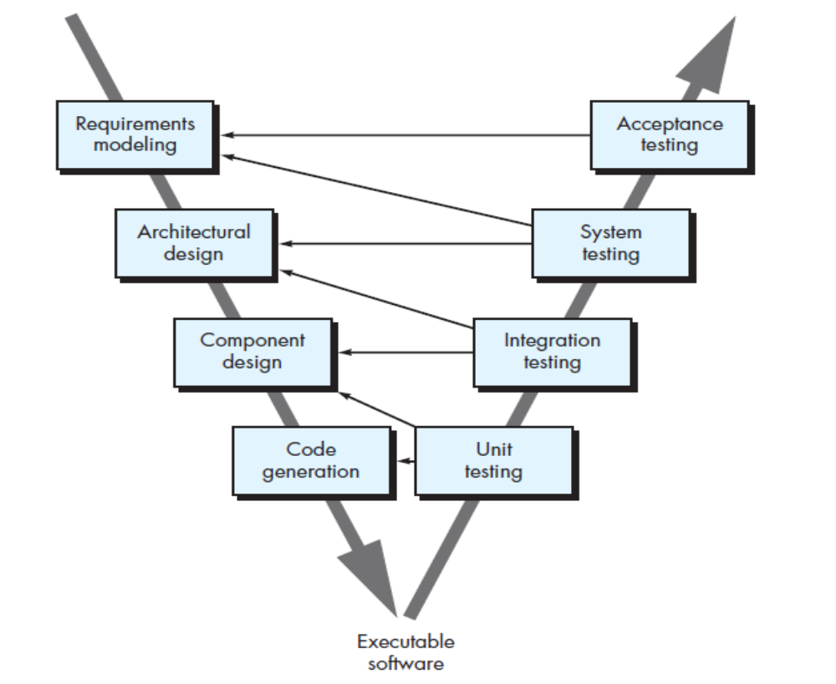
Chapter 3 Testing in the Software Life Cycle

Slide 3
Chapter 3 Testing in the Software Life Cycle
3.2 Component Test
3.2.1 Explanation of Terms
Depending on the programming language the developers used, these software units may be called by different names, such as, for example,modules and units. In object-oriented programming, they are called classes. The respective tests, therefore, are called module tests, unit tests, and class tests.
Generally, we speak of software units or components. Testing of a single software component is therefore called component testing.
Test basis:Component testing is based on component requirements, that is the component design spec (or detailed design spec). If white box test cases will be developed or white box test coverage will be measured,

Slide 4
Chapter 3 Testing in the Software Life Cycle
the source code can also be analyzed. However, the component behavior must be compared with the component specification.
3.2.2 Test objects
Typical test objects are program modules/units or classes, (database) scripts, and other software components. The main characteristic of component testing is that the software components are tested individually and isolated from all other software components of the system.
3.2.3 Test Environment
In the VSR subsystem DreamCar, the specification for calculating the price of the car states the following:
■ The starting point is baseprice minus discount, where baseprice is the general basic price of the vehicle and discount is the discount to this price granted by the dealer.

Slide 5
Chapter 3 Testing in the Software Life Cycle
■ A price (specialprice) for a special model and the price for extra equipment items (extraprice) shall be added.
■ If three or more extra equipment items (which are not part of the special model chosen) are chosen (extras), there is a discount of 10 percent on these particular items. If five or more special equipment items are chosen, this discount is increased to 15 percent.
■ The discount that is granted by the dealer applies only to the baseprice,whereas the discount on special items applies to the special items only. These discounts cannot be combined for everything.
The following C++function calculates the total price (Actually, there is a defect in this program: Discount calculation for >= 5 is not reachable.The defect is used when explaining the use of white box analysis in chapter 5.):

Slide 6
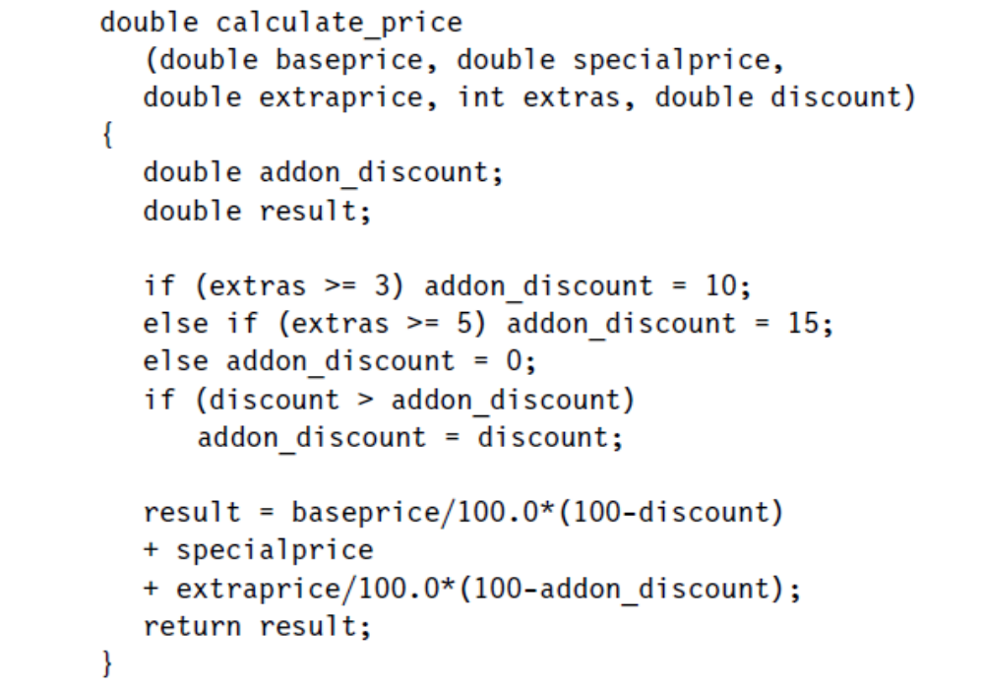
Chapter 3 Testing in the Software Life Cycle
extraprice is the total price of extra equipment items.
specialprice is the price of specical modes besides models basic model price(baseprice).

Slide 7
Chapter 3 Testing in the Software Life Cycle
In order to test the price calculation, the tester uses the corresponding class interface calling the function calculate_price() with appropriate parameters and data. Then the tester records the function’s reaction to the function call. That means reading and recording the return value of the previous function call. For that, a test driver is necessary. A test driver is a program that calls the component under test and then receives the test object’s reaction.
For the test object calculate_price(), a very simple test driver could look like this(Floating point numbers should not be directly compared, as there may be imprecise rounding. As the result for price can be less than 12900.00, the absolute value of the difference of “price” and 12900.00 must be evaluated.):

Slide 8
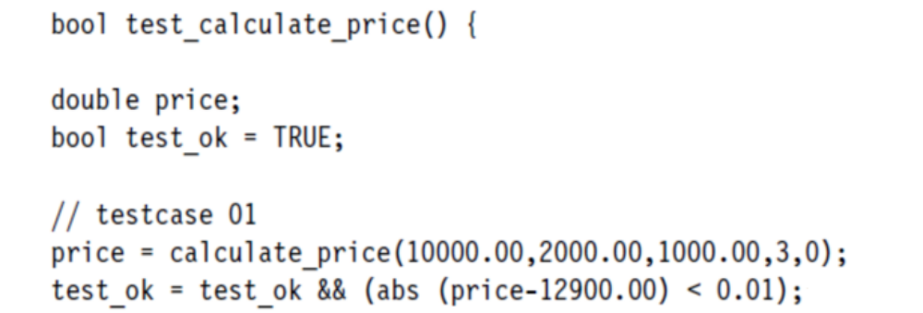
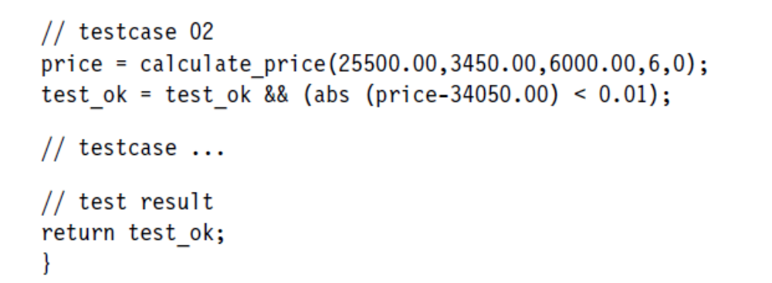
Chapter 3 Testing in the Software Life Cycle

Slide 9
Chapter 3 Testing in the Software Life Cycle
test driver is programmed in a very simple way. Some useful extensions could be, for example, a facility to record the test data and the results, including date and time of the test, or a function that reads test cases from a table, file, or database.
■ Use of component testing frameworks reduces the effort involved in programming test drivers and helps to standardize a project's component testing architecture. Junit , nUnit and CppUnit for C++ are the examples of these frameworks.
3.2.4 Test objectives
The most important task of component testing is to check that the entire functionality of the test object works correctly and completely as required by its specification.

Slide 10
Chapter 3 Testing in the Software Life Cycle
functionality means the input/output behavior of the test object. To check the correctness and completeness of the implementation, the component is tested with a series of test cases, where each test case covers a particular input/ output combination (partial functionality).
Typical software defects found during functional component testing are incorrect calculations or missing or wrongly chosen program paths (e.g.,special cases that were forgotten or misinterpreted). when the whole system is integrated, each software component must be able to cooperate with many neighboring components and exchange data with them. A component may then possibly be called or used in a wrong way, i.e., not in accordance with its specification. In such cases, the wrongly used component should not just suspend its service or cause

Slide 11
Chapter 3 Testing in the Software Life Cycle
the whole system to crash. Rather, it should be able to handle the situation in a reasonable and robust way. This is why testing for robustness is another very important aspect of component testing. The way to do this is the same as in functional testing. However, the test focuses on items either not allowed or forgotten in the specification. The tests are function calls, test data, and special cases. Such test cases are also called negative tests. The component’s reaction should be an appropriate exception handling. If there is no such exception handling, wrong inputs can trigger domain faults, Such faults could lead to a program crash.
In the price calculation example, such negative tests are function calls with negative values, values that are far too large, or wrong data types (for example, char instead of int):

Slide 12
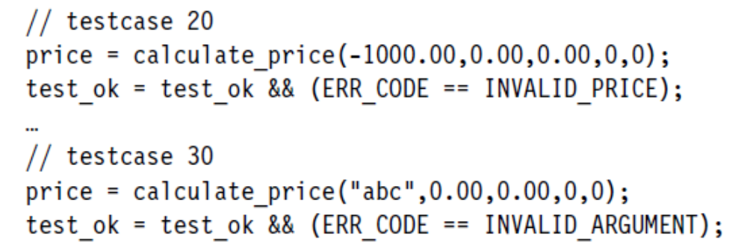
Chapter 3 Testing in the Software Life Cycle
Some interesting aspects become clear:
■ There are at least as many reasonable negative tests as positive ones.
■ The test driver must be extended in order to be able to evaluate the test object’s exception handling.
■ The test object’s exception handling (the analysis of ERR_CODE in the previous example) requires additional functionality. Often more than 50% of the program code deals with exception handling. Robustness has its cost.

Slide 13
Chapter 3 Testing in the Software Life Cycle
Sometimes,nonfunctional characteristics like efficiency and maintainability will be tested.
Efficiency refers to how efficiently the component uses computer. Here we have various aspects such as use of memory, computing time, disk or network access time, and the time required to execute the component’s functions and algorithms. In contrast to most other nonfunctional tests, a test object’s efficiency can be measured during the test. Efficiency is usually only verified in efficiency-critical components of the system or if efficiency requirements are explicitly stated by specifications.
A maintainability test includes all the characteristics of a program that have an influence on how easy or how difficult it is to change the program or to continue developing it.

Slide 14
Chapter 3 Testing in the Software Life Cycle
The following aspects are most important for testing maintainability: code structure, modularity, quality of the comments in the code, adherence to standards, understandability, and currency of the documentation.
The code in the example calculate_price() is not good enough. There are no comments, and numeric constants are not declared but are just written into the code. If such a value must be changed later, it is not clear whether and where this value occurs in other parts of the system, nor is it clear how to find and change it.
Of course, such characteristics cannot be tested by dynamic tests (see chapter 5). Analysis of the program text and the specifications is necessary.Static testing, and especially reviews (see section 4.1) are the correct means for that purpose.

Slide 15
Chapter 3 Testing in the Software Life Cycle
3.2.5 Test Strategy
As we explained earlier, component testing is very closely related to development. The tester usually has access to the source code, which makes component testing the domain of white box testing (see section 5.2).
The tester can design test cases using her knowledge about the component’s program structures, functions, and variables. Access to the program code can also be helpful for executing the tests. With the help of special tools (debugger or white box testing tool ), it is possible to observe program variables during test execution.
In reality, however, component testing is often done as a pure black box testing, which means that the code structure is not used to design test cases.(This is a serious flaw because 60 to 80% of the code often is never executed—a perfect hideout for bugs.)

Slide 16
Chapter 3 Testing in the Software Life Cycle
On the one hand, real software systems consist of countless elementary components and which components will be tested during the component testing(importance of components,programmer experience.....)?
Test first programming is a modern approach in component testing. The idea is to design and automate the tests first and program the desired component afterwards. This approach is very iterative. The program code is tested with the available test cases. The code is improved until it passes the tests. This is also called test-driven development.
3.3 Integration Test
3.3.1 Explanation of Terms
A precondition for integration testing is that the test objects subjected to it (i.e., components) have already been tested. Defects should, if possible, already have been corrected.

Slide 17
Chapter 3 Testing in the Software Life Cycle
Developers, testers, or special integration teams then compose groups of these components to form larger structural units and subsystems. This connecting of components is called integration.
Then the structural units and subsystems must be tested to make sure all components collaborate correctly. Thus, the goal of the integration test is to expose defects/errors in the interfaces and in the interaction between integrated components.
The test basis may be the software or system architecture（architectural design specification）.
The VSR subsystem DreamCar (see figure 2-1) consists of several elementary components.

Slide 18
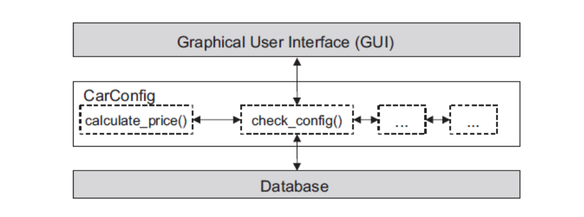
Chapter 3 Testing in the Software Life Cycle
One element is the class CarConfig（one class of subsystem DreamCar ）with the methods calculate_price(),check_config(), and other methods. check_config() retrieves all the vehicle data from a database and presents them to the user through a graphical user interface(GUI).
When the user has chosen the configuration of a car, check_config() executes a plausibility check of the configuration (base model of the vehicle, special

Slide 19
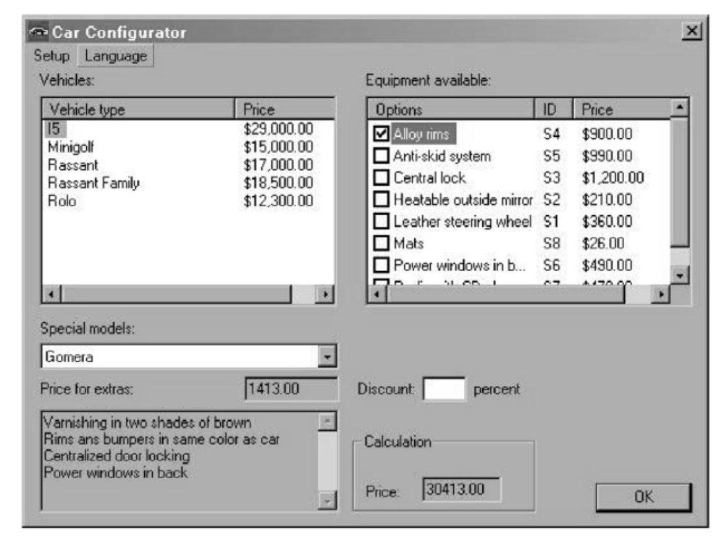
Chapter 3 Testing in the Software Life Cycle
Figure 3–3User interface for the VSR subsystem DreamCar

Slide 20
Chapter 3 Testing in the Software Life Cycle
equipment, list of further extra items) and then calculates the price. In this example (see figure 3-3), the total resulting price from the base model of the chosen vehicle, the special model, and the extra equipment should be $29000 + $1413 + $900 = $31313. However, the price indicated is only $30413. Obviously, in the current program version, accessories (e.g., alloy rims) can be selected without paying for them. Somewhere between the GUI and calculate_price(), the fact that alloy rims were chosen gets lost.
If the test protocols of the previous component tests show that the error/defect is neither in the function calculate_price() nor in check_config(), the cause of the problem could be a faulty data transmission between the

Slide 21
Chapter 3 Testing in the Software Life Cycle
GUI and check_config() or between check_config() and calculate_price().
Even if a complete component test had been executed earlier, such interface problems can still occur. Because of this, integration testing is necessary as a further test level. Its task is to find collaboration and interoperability problems and isolate their causes.
Integration of the single components to the subsystem DreamCar is just the beginning of the integration test in the project VSR. The other subsystems of the VSR (see chapter 2, figure 2-1) must also be integrated. Then, the subsystems must be connected to each other. DreamCar has to be connected to the subsystem ContractBase, which is connected to the subsystems JustInTime (order management), NoRisk (vehicle insurance), and

Slide 22
Chapter 3 Testing in the Software Life Cycle
EasyFinance (financing). In one of the last steps of integration, VSR is connected to the external mainframe in the IT center of the enterprise.
component integration testing;
system integration testing(System integration testing can be executed only after system testing,The development team has only one-half of such an external interface under its control.This constitutes a special risk.).
if business processes are implemented as a workflow through several interfacing systems and problems occur, it may be very expensive and challenging to find the defect in a special component or interface.
3.3.2 Test objects
The most important test objects of integration testing are

Slide 23
Chapter 3 Testing in the Software Life Cycle
internal interfaces between components. Integration testing may also comprise configuration programs and configuration data. Finally, integration or system integration testing examines subsystems for correct database access and correct use of other infrastructure components.
3.3.3 The Test Environment
As with component testing, test drivers/stubs are needed in the integration test. They send test data to the test objects, and they receive and log the results.
If the component test was well organized, then some test drivers/stubs should be available. It could be one generic test driver/stub for all components or at least test drivers/stubs that were designed with a common architecture.

Slide 24
Chapter 3 Testing in the Software Life Cycle
During integration testing, additional tools, called monitors, are required. Monitors are programs that read and log data traffic between components. Special monitors must be developed for the observation of project-specific component interfaces.
3.3.4 Test objectives
The test objectives are to reveal interface problems as well as conflicts between integrated parts.
Interface formats may not be compatible with each other. These kinds of problems can only be found by dynamic testing. They are errors/defects in the data exchange or in the communication between the components.
As in the following examples:

Slide 25
Chapter 3 Testing in the Software Life Cycle
■ A component transmits syntactically incorrect or no data. The receiving component cannot operate or crashes (functional fault in a component,incompatible interface formats, protocol faults).
■ The communication works but the involved components interpret the received data differently (functional fault of a component, contradicting or misinterpreted specifications).
■ Data is transmitted correctly but at the wrong time, or it is late (timing problem), or the intervals between the transmissions are too short (throughput, load, or capacity problem).

Slide 26
Chapter 3 Testing in the Software Life Cycle
The following interface failures could occur during the VSR integration test. These can be attributed to the previously mentioned failure types:
■ In the GUI of the DreamCar subsystem, selected extra equipment items are not passed on to check_config(). Therefore, the price and the order data would be wrong.
■ In DreamCar, a certain code number (e.g., 442 for metallic blue) represents the color of the car. In the order management subsystem running on the external mainframe, however, some code numbers are interpreted differently (for example, 442 may represent red).
■ The mainframe computer confirms an order after checking whether delivery would be possible. In some cases, this examination takes so long that the VSR assumes a transmission failure and aborts the order.

Slide 27
Chapter 3 Testing in the Software Life Cycle
Nonfunctional tests may also be executed during integration testing, if attributes mentioned below are important or are considered at risk. These attributes may include reliability, performance, and capacity.
3.3.5 Integration Strategies
The test manager has to choose and implement an optimal integration strategy for the project considering cost and benefit.
An obvious ad hoc strategy to integrate the components in the order in which they are ready. This means that as soon as a component has passed the component test, it is checked to see if it fits with another already tested component or if it fits into a partially integrated subsystem. If so, both parts are integrated and the integration test between both of them is executed.

Slide 28
Chapter 3 Testing in the Software Life Cycle
Which strategy is optimal (the most timesaving and least costly strategy) depends on the individual circumstances in each project. When making plans, the test manager can follow these generic integration strategies:
■ Top-down integration(Stubs replace all subordinate components);
■ Bottom-up integration(No stubs are needed,Test drivers must simulate higher-level components);
■ Ad hoc integration(The components are being integrated in the (casual) order in which they are finished,Stubs as well as test drivers are required.);
■ Backbone integration(A skeleton or backbone is built and components are gradually integrated into it)

Slide 29
Chapter 3 Testing in the Software Life Cycle
Top-down and Bottom-up integration in their pure form can be applied only to program systems that are structured in a strictly hierarchical way(C language);
Any nonincremental integration also called big bang integration—should be avoided. Big bang integration means waiting until all software elements are developed and then throwing everything together in one step.
3.4 System Test
3.4.1 Explanation of Terms
After the integration test is completed, the third and next test level is the system test. System testing checks if the integrated product meets the specified requirements.
The reasons for system test are as follows:
■ In the lower test levels, the testing was done against

Slide 30
Chapter 3 Testing in the Software Life Cycle
technical specifications, i.e., from the technical perspective of the software producer. The system test, though, looks at the system from the perspective of the customer and the future user.The testers validate whether the requirements are completely and appropriately implemented.
■ Many functions and system characteristics result from the interaction of all system components; consequently, they are visible only when the entire system is present and can be observed and tested only there.
The test basis includes all documents or information describing the test object on a system level. This may be system requirements(and analysis)specifications,risk analyses if present, user manuals, etc.
3.4.2 Test Objects and Test Environment

Slide 31
Chapter 3 Testing in the Software Life Cycle
The system test tests the system as a whole in an environment as similar as possible to the intended production environment.
The hardware and software products that will be used later should be installed on the test platform (hardware, system software, device driver software, networks, external systems, etc.).
Following figure shows an example of the VSR-System test environment.
The system test not only tests the system itself, it also checks system and user documentation, like system manuals, user manuals, training material, and so on.
Testing configuration settings as well as optimizing the system configuration during load and performance testing (see section 3.7.2) must often be covered.

Slide 32
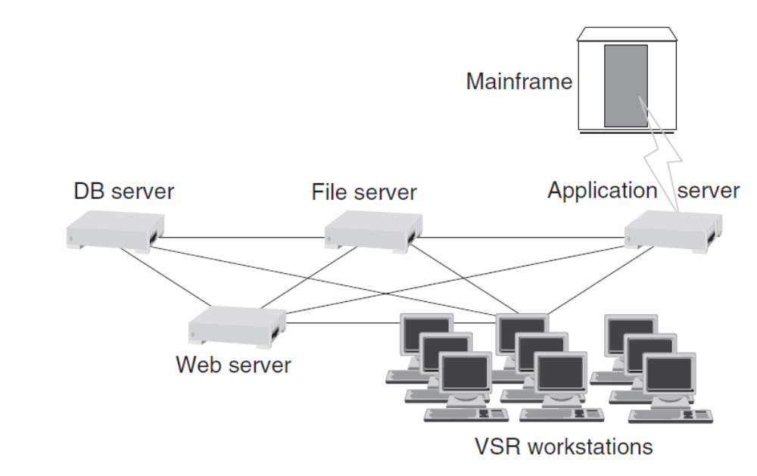
Chapter 3 Testing in the Software Life Cycle

Slide 33
Chapter 3 Testing in the Software Life Cycle
It is getting more and more important to check the quality of data in systems that use a database or large amounts of data. The data itself will then be new test objects. It must be assured that it is consistent, complete, and up-to-date.
3.4.3 Test Objectives
It is the goal of the system test to validate whether the complete system meets the specified functional and nonfunctional requirements (see sections 3.7.1 and 3.7.2) and how well it does that. Failures from incorrect, incomplete, or inconsistent implementation of requirements should be detected. Even undocumented or forgotten requirements should be identified.
3.4.4 Problems in System Test Practice

Slide 34
Chapter 3 Testing in the Software Life Cycle
In (too) many projects, the requirements are incompletely or not at all written down. The problem this poses for testers is that it’s unclear how the system is supposed to behave. This makes it hard to find defects.
If there are no requirements, then all behaviors of a system would be valid and assessment would be impossible. Of course, the users or the customers have a certain perception of what they expect of “their” software system. One possible technique to cope with such a situation is exploratory testing (see section 5.3).
If the requirements have never been documented, reviewed, or released during the project, the testing is very difficult.
3.5 Acceptance Test

Slide 35
Chapter 3 Testing in the Software Life Cycle
Before installing and using the software in real life,another last test level must be executed: the acceptance test.
The acceptance test may be the only test that the customers are actually involved in or that they can understand. The customer may even be responsible for this test!
There are four typical forms of acceptance testing:
■ Contract acceptance testing
■ User acceptance testing
■ Operational acceptance testing
■ Field testing (alpha and beta testing)
The test basis for acceptance testing can be any document describing the system from the user or customer viewpoint, such as, for example,user or system requirements spec, use

Slide 36
Chapter 3 Testing in the Software Life Cycle
cases, business processes, risk analyses,user process descriptions, forms, reports, and laws and regulations as well as descriptions of maintenance and system administration rules and processes.
3.5.1 Contract Acceptance Testing
If customer-specific software was developed, the customer will perform contract acceptance testing. The test criteria are the acceptance criteria determined in the development contract. Additionally, conformance to any governmental, legal, or safety regulations must be addressed here.
Because the supplier may have misunderstood the acceptance criteria, it is very important that the acceptance test cases are designed by or at least thoroughly reviewed by the customer.

Slide 37
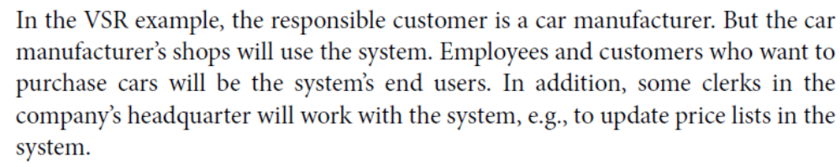
Chapter 3 Testing in the Software Life Cycle
Acceptance testing is run in the customer’s actual operational environment.
The same techniques used for test case design in system testing can be used to develop acceptance test cases. For administrative IT systems, business transactions for typical business periods (like a billing period) should be considered.
3.5.2 Testing for User Acceptance
Such a test is especially recommended if the customer and the user are different.

Slide 38
Chapter 3 Testing in the Software Life Cycle
Different user groups usually have completely different expectations of a new system. Users may reject a system because they find it “awkward” to use, which can have a negative impact on the introduction of the system. This may happen even if the system is completely OK from a functional point of view.
Each user group selects test cases based on business processes and typical usage scenarios.
3.5.3 Operational (Acceptance) Testing
Operational (acceptance) testing assures the acceptance of the system by the system administrators.It may include testing of backup/restore cycles (including restoration of copied data), disaster recovery, user management, and checks of security vulnerabilities.

Slide 39
Chapter 3 Testing in the Software Life Cycle
3.5.4 Field Testing
If the system is intended for the general market, the software producer may choose to execute a field test after the system test. The objective of the field test is to identify influences from users’ environments.
For this purpose, the producer delivers stable prerelease versions of the software to preselected customers who adequately represent the market for this software or whose operational environments are appropriately similar to possible environments for the software. They give feedback to the producer about the problems they encountered along with general comments and impressions about the new product. Such testing of preliminary versions by representative customers is also called alpha testing or beta testing.

Slide 40
Chapter 3 Testing in the Software Life Cycle
Alpha tests are carried out at the producer’s location, while beta tests are carried out at the customer’s site.
A new term in software testing is dogfood test. It refers to a kind of internal field testing where the product is distributed to and used by internal users in the company that developed the software. The idea is that “if you make dogfood, try it yourself first.” Large suppliers of software like Microsoft and Google advocate this approach before beta testing.
3.6 Testing New Product Versions
Until now, it was assumed that a software development project is finished when the software passes the acceptance test and is deployed. But that’s not the reality. The first deployment marks only the beginning of the software life cycle. the software will often be used for years

Slide 41
Chapter 3 Testing in the Software Life Cycle
or decades and is changed, updated, and extended many times.
3.6.1 Software Maintenance（maintenance work necessary because of failures）
The purpose of software maintenance is not to maintain the ability to operate or to repair damages caused by use. Defects do not originate from wear and tear.
We speak of software maintenance that is adaptive maintenance, updates of operating systems, databases, middleware or when defects that have been in the product before are corrected (corrective maintenance).
Testing changes made during maintenance can be difficult because the system’s specifications are often out of date or missing, especially in the case of legacy systems.

Slide 42
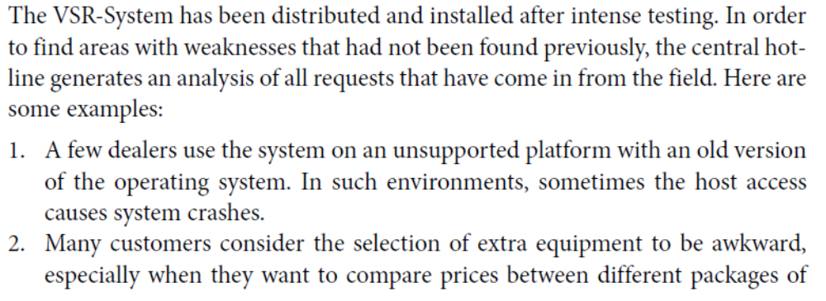
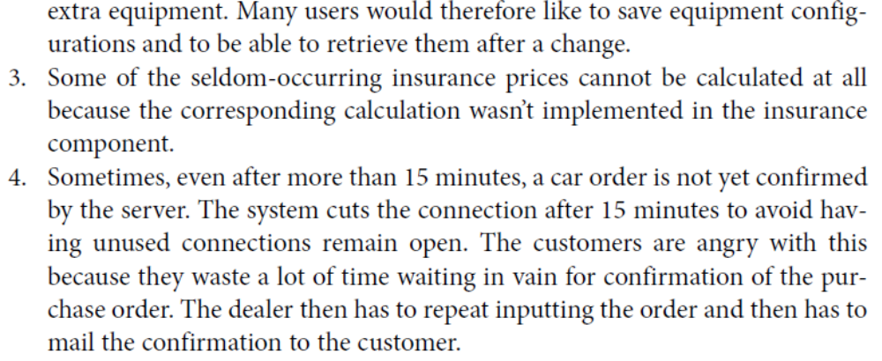
Chapter 3 Teting in the Software Life Cycle

Slide 43
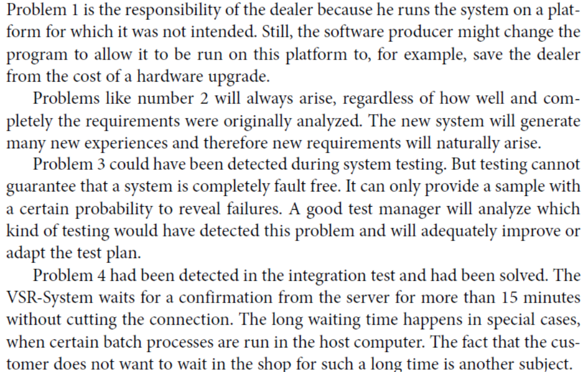
Chapter 3 Testing in the Software Life Cycle

Slide 44
Chapter 3 Testing in the Software Life Cycle
These four examples represent typical problems that will be found in even the most mature software system:
1. The system is run under new operating conditions that were not predictable and not planned.
2. The customers express new wishes.
3. Functions are necessary for rarely occurring special
cases that were not anticipated.
4. Crashes that happen rarely or only after a very long run time are reported. These are often caused by external influences.
Therefore, after its deployment, every software system requires certain corrections and improvements. In this context, we speak of software maintenance.
The remainder of the system should be regression tested

Slide 45
Chapter 3 Testing in the Software Life Cycle
(see section 3.7.4) as comprehensibly as possible.
Testing for the retirement of a system should include the testing of data archiving or data migration into the future system.
3.6.2 Testing after Further Development
Apart from maintenance work necessary because of failures, there will be changes and extensions to the product.
As with maintenance testing, anything new or changed should be tested, and the remainder of the system should be regression tested to find unexpected side effects.
3.6.3 Testing in Incremental Development
Incremental development means that the project is not done in one time. System functionality and reliability will

Slide 46
Chapter 3 Testing in the Software Life Cycle
grow over time.
The early releases allow customer feedback early and continuously.
Incremental development includes imcremental model,Prototyping,Spiral Model,Extreme Programming
(XP),SCRUM...
Testing must be adapted to such development models, and continuous integration testing and regression testing are necessary.
This danger(reliability to decrease...) can be reduced by running several V-models in sequence,one for each increment, where every next “V” reuses existing test material and adds the tests necessary for new development or for higher reliability requirements.

Slide 47
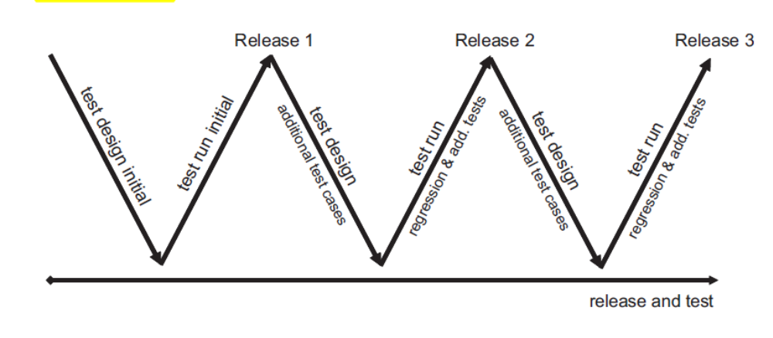
Chapter 3 Testing in the Software Life Cycle

Slide 48
Chapter 3 Testing in the Software Life Cycle
3.7 Generic Types of Testing
The previous chapters gave a detailed view of testing in the software life cycle, distinguishing several test levels. Focus and objectives change when testing in these different levels. And different types of testing are relevant on each test level.
The following types of testing can be distinguished:
■ Functional testing
■ Nonfunctional testing
■ Testing of software structure
■ Testing related to changes
3.7.1 Functional Testing
Functional testing includes all kind of tests that verify a system’s input/output behavior.

Slide 49
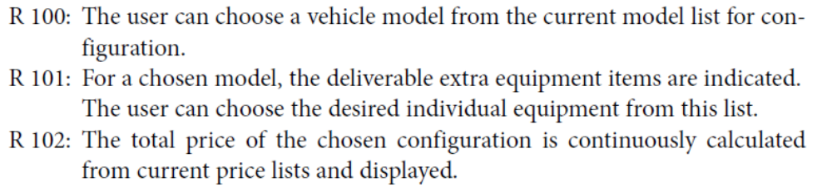
Chapter 3 Testing in the Software Life Cycle
To design functional test cases, the black box testing methods discussed in section 5.1 are used, and the test bases are the functional requirements.
Functional requirements specify the behavior of the system; Characteristics of functionality, according to [ISO 9126], are suitability,accuracy, interoperability, and security.
The following text shows a part of the requirements paper concerning price calculation for the system VSR (see section 3.2.4).

Slide 50
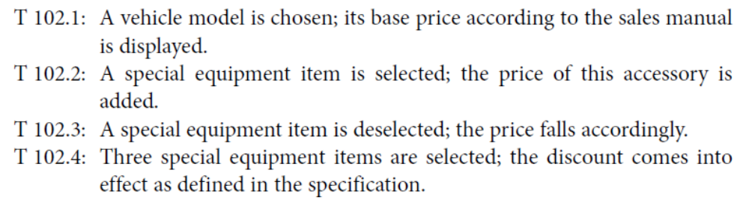
Chapter 3 Testing in the Software Life Cycle
Requirements-based testing uses the final requirements as the basis for testing. For each requirement, at least one test case is designed and documented in the test specification. The test specification is then reviewed.
The testing of requirement 102 in the preceding example could look like the following example. Usually, more than one test case is needed to test a functional requirement.
Using black box test methods (e.g., equivalence partitioning), these test cases can be further refined and

Slide 51
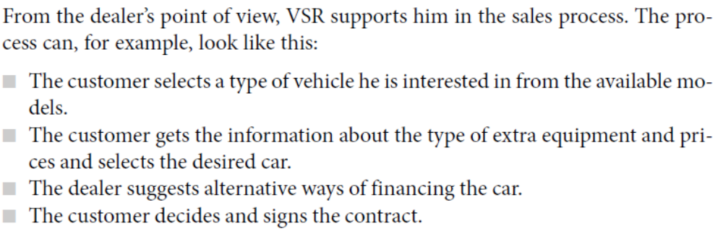
Chapter 3 Testing in the Software Life Cycle
extended if desired.
Requirements-based functional testing as shown is mainly used in system testing and other higher levels of testing.
business-process-based testing or use-case-based testing are other similar suitable testing methods.
A business process analysis (which is usually elaborated as part of the requirements analysis) shows which business processes are relevant and how often and in which context they appear.

Slide 52
Chapter 3 Testing in the Software Life Cycle
Test scenarios simulating typical business processes are constructed based on this analysis.
Requirements-based testing focuses on single system functions (e.g.,the transmission of a purchase order). Business-process-based testing,however, focuses on the whole process consisting of many steps (e.g., the sales conversation, consisting of configuring a car, agreeing on the purchase contract, and the transmission of the purchase order).
3.7.2 Nonfunctional Testing
They describe the attributes of the functional behavior or the attributes of the system as a whole.
The following nonfunctional system characteristics should be considered in the tests (usually in system testing):

Slide 53
Chapter 3 Testing in the Software Life Cycle
■ Load test: Measuring of the system behavior for increasing system loads (e.g., the number of users that work simultaneously, number of transactions)
■ Performance test: Measuring the processing speed and response time for particular use cases, usually dependent on increasing load
■ Volume test: Observation of the system behavior dependent on the amount of data (e.g., processing of very large files)
■ Stress test: Observation of the system behavior when the system is overloaded
■ Testing of security against unauthorized access to the system or data,denial of service attacks, etc.
■ Stability or reliability test: Performed during permanent

Slide 54
Chapter 3 Testing in the Software Life Cycle
operation (e.g., mean time between failures or failure rate with a given user profile)
■ Robustness test: Measuring the system’s response to operating errors, bad programming, hardware failure, etc. as well as examination of exception handling and recovery
■ Testing of compatibility and data conversion: Examination of compatibility with existing systems, import/export of data, etc.
■ Testing of different configurations of the system: For example, different versions of the operating system, user interface language, hardware platform, etc. (back-to-back testing)
■ Usability test: Examination of the ease of learning the system, ease and efficiency of operation, understandability

Slide 55
Chapter 3 Testing in the Software Life Cycle
of the system outputs, etc.,always with respect to the needs of a specific group of users ([ISO9241], [ISO 9126])
■ Checking of the documentation: For compliance with system behavior(e.g., user manual and GUI)
■ Checking maintainability: Assessing the understandability of the system documentation and whether it is up-to-date; checking if the system has a modular structure; etc.
A major problem in testing nonfunctional requirements is the often imprecise and incomplete expression of these requirements. Expressions like “the system should be easy to operate” and “the system should be fast” are not testable in this form.

Slide 56
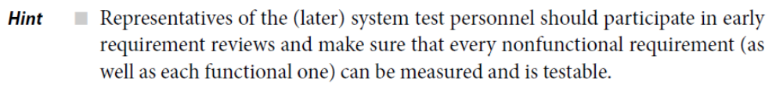
Chapter 3 Testing in the Software Life Cycle
3.7.3 Testing of Software Structure
Structural techniques (structure-based testing, white box testing) use information about the test object’s internal code structure or architecture.
Typically, the control flow in a component, the call hierarchy of procedures, or the menu structure is analyzed.
Structural techniques are most used in component and integration testing, but they can also be applied at higher levels of testing, typically as extra tests (for example, to cover menu structures). Structural techniques are covered in detail in sections 4.2 and 5.2.

Slide 57
Chapter 3 Testing in the Software Life Cycle
3.7.4 Testing Related to Changes and Regression Testing
When changes are implemented, parts of the existing software are changed or new modules are added.
A regression test is a new test of a previously tested program following modification to ensure that faults have not been introduced or uncovered as a result of the changes made (uncovering masked defects).
Regression testing may be performed at all test levels and applies to functional, nonfunctional, and structural test.
Test cases to be used in regression testing must be well documented and reusable. Therefore, they are strong candidates for test automation.
The question is how extensive a regression test has to be. There are the following possibilities:

Slide 58
Chapter 3 Testing in the Software Life Cycle
1. Rerunning of all the tests that have detected failures whose reasons(the defects) have been fixed in the new software release (defect retest,confirmation testing)
2. Testing of all program parts that were changed or corrected (testing of altered functionality)
3. Testing of all program parts or elements that were newly integrated (testing of new functionality)
4. Testing of the whole system (complete regression test)
A bare retest 1as well as tests that execute only the area of modifications 2 and 3 are not enough because simple local code changes can create side effects.
In practice, a complete regression test is usually too time consuming and expensive. Therefore, we are looking for criteria that can help to choose which old test cases can be

Slide 59
Chapter 3 Testing in the Software Life Cycle
omitted without losing too much information. As always, in testing this means balancing risk and cost. The following test selection strategies are often used:
■ Repeating only the high-priority tests according to the test plan
■ In the functional test, omitting certain variations (special cases)
■ Restricting the tests to certain configurations only (e.g., testing of the English product version only, testing of only one operating system version)
■ Restricting the test to certain subsystems or test levels
Generally, the rules listed here refer to the system test. On the lower test levels, regression test criteria can also be based on design or architecture documents (e.g., class hierarchy) or white box information

